Slide 1
UBS Group Technology & Operations Case Challenge 2017

Slide 2


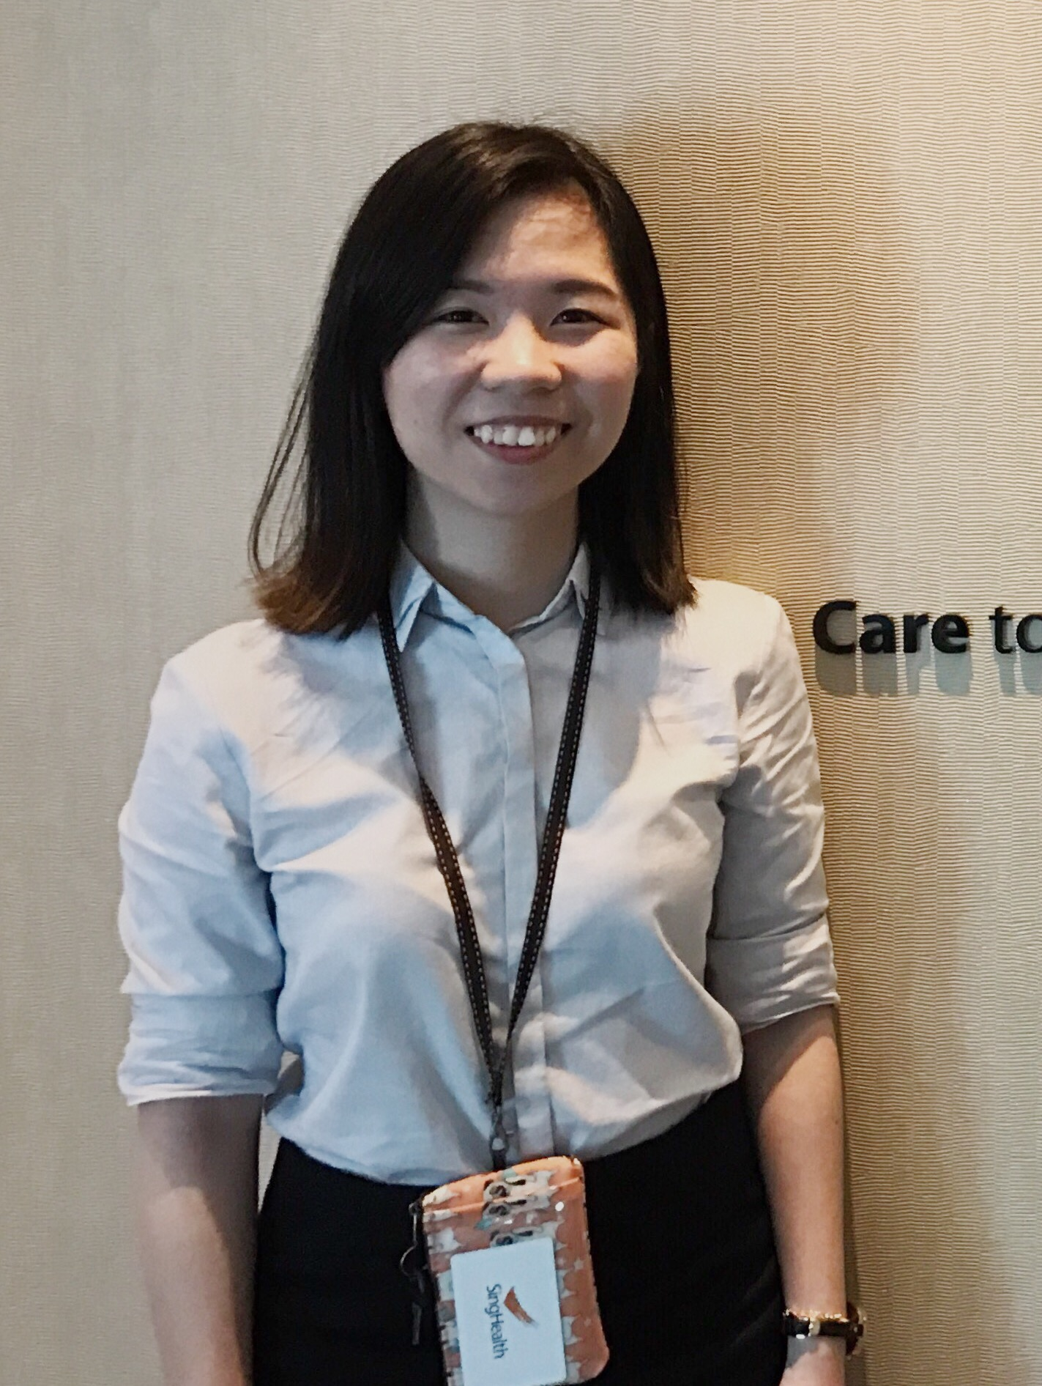
The Team
Edward Tan
Li Xinyi
Pearlyn Lim

Slide 3





The Journey
Solution
Cost vs Benefits
Conclusion
Problem
Demo
Limitation

Slide 4
The Journey
Solution
Cost vs Benefits
Conclusion
Problem
Demo
Limitation

Slide 5





Problem
Elite Bank

Slide 6
Problem
Corrective over preventive
Inefficient problem-solving process
Lack of real-time management
Elite Bank

Slide 7

Lack of real-time management

Slide 8




Lack of real-time management
Problem1:
Accumulation of errors
Too late to correct
End of day - P&L Reports
High pressure

Slide 9
Inefficient problem-solving process

Slide 10





Inefficient problem solving process
Problem2:
No automation
Guess and check
Identify and solve
Unnecessary communication

Slide 11
Corrective over preventive

Slide 12




Corrective over preventive
Problem3:
Recurring problems
Cure
VS
Economic losses
Prevention

Slide 13
The Journey
Solution
Cost vs Benefits
Conclusion
Problem
Demo
Limitation

Slide 14
The Journey
Solution
Cost vs Benefits
Conclusion
Problem
Demo
Limitation

Slide 15
CheckBot

Slide 16




Solution:
CheckBot
Three Line of Defence Checks
Revised Operational Flow + Automation
Enhanced Process of resolving discrepancies
Machine Learning Capabilities

Slide 17
Original Process

Slide 18
Solution:
Original process
Reuters
Trades booked by traders
Yahoo
External Market
Data
TradeCatcher
External Market
Data
Bloomberg
Original System in Elite Bank
TradeLife
MarketBox
RMS
TradeClip
P&L report Production
MoneyClip
StatBox
WorldDating

Slide 19
Three Lines of Defence

Slide 20
Solution:
Three Lines of Defence
Trades booked by traders
TradeCatcher
TradeLife
RMS
TradeClip
P&L report Production
CheckBot

Slide 21
Solution:
1st Line of Defence
Trades booked by traders
RMS
TradeCatcher
1st Clear
P&L report Production
TradeVerifier
TradeLife
Discrepancy
Analysis Wing
With Machine Learning
TradeClip
Database for
Analysis
Alert System

Slide 22
Solution:
2nd Line of Defence
Trades booked by traders
Automated Generation P&L for traders
Intermediate P&L report 1
RMS
Intermediate P&L report 1
Intermediate P&L report n
TradeCatcher
1st Clear
Intermediate P&L report n
Intermediate
P&L verifier
P&L report Production
TradeVerifier
TradeLife
2nd Clear
Discrepancy
Discrepancy
Analysis Wing
With Machine Learning
TradeClip
Database for
Analysis
Alert System

Slide 23
Solution:
3rd Line of Defence
Trades booked by traders
Automated Generation P&L for traders
Intermediate P&L report 1
RMS
Intermediate P&L report 1
Consolidated P&L report
Consolidated P&L report
Intermediate P&L report n
TradeCatcher
1st Clear
Intermediate P&L report n
3rd Clear
Intermediate
P&L verifier
Consolidated
P&L verifier
P&L report Production
TradeVerifier
TradeLife
2nd Clear
Discrepancy
Discrepancy
Discrepancy
Analysis Wing
With Machine Learning
TradeClip
Database for
Analysis
Alert System

Slide 24
Solution:
Three Lines of Defence
Trades booked by traders
Automated Generation P&L for traders
Intermediate P&L report 1
RMS
Intermediate P&L report 1
Consolidated P&L report
Consolidated P&L report
Intermediate P&L report n
TradeCatcher
1st Clear
Intermediate P&L report n
3rd Clear
Intermediate
P&L verifier
Consolidated
P&L verifier
P&L report Production
TradeVerifier
TradeLife
2nd Clear
Discrepancy
Discrepancy
Discrepancy
Analysis Wing
With Machine Learning
TradeClip
Database for
Analysis
Alert System

Slide 25
Speed up process with expertise and technology

Slide 26

Solution:
Perfect combination
Outsourcing data and error analysis tasks to skilled expertise
Outsourced Core Team of Analyst
Machine Learning Technology
Assist trouble-shooting process with CheckBot’s suggestions and database which are improved continuously with machine-learning mechanism

Slide 27
Solution:
Process of resolving discrepancies (1)
CheckBot
database
RMS
Alert Message from CheckBot
CheckBot
database
Feedback for learning
Send data after errors cleared
Core Team of Analysts receives alert
Verifier signals:
“Issue Resolved”
Errors Present?
Yes
Run checks against CheckBot database to match any existing cases
Yes
New Case?
No
Analyst analyses and proposes solutions and people to notify
Analyst chooses best course of actions based on CheckBot’s suggestions
Analyst notify responsible parties to resolve errors:
DI Team /Traders /Others
Yes
No
Errors solved?
In-House
Outsourced

Slide 28
Solution:
Process of resolving discrepancies (2)
Alert Message from CheckBot
Core Team of Analysts receives alert
Errors Present?
No
(False Alarm)
Verifier signals:
“Issue Resolved”
Feedback for learning
Send data after errors cleared
CheckBot
database
RMS
In-House
Outsourced

Slide 29
Solution:
Process of resolving discrepancies
CheckBot
database
RMS
Alert Message from CheckBot
CheckBot
database
Feedback for learning
Send data after errors cleared
Core Team of Analysts receives alert
Verifier signals:
“Issue Resolved”
No
(False Alarm)
Errors Present?
Yes
Run checks against CheckBot database to match any existing cases
Yes
New Case?
No
Analyst analyses and proposes solutions and people to notify
Analyst chooses best course of actions based on CheckBot’s suggestions
Analyst notify responsible parties to resolve errors:
DI Team /Traders /Others
Yes
No
Errors solved?
In-House
Outsourced

Slide 30
Solution:
Outsourcing
Efficient
Secured
Diversified
Outsourced team analyzes and identifies responsible parties, and the in-house team will notify the related personnels to resolve the issue
Client’s details encrypted and non-disclosure contracts signed
Various alternative vendors available in case one fails

Slide 31
Solution:
Outsourcing VS Offshoring
Criteria | Outsourcing | Offshoring
Duration of problem-solving process | Real-time data management | Lead time required
Necessity | Need for expertise in data analysis and trouble-shooting | No need for 24/7 global help desk
Cost | Relatively lower as compared UBS staff | Much lower in developing countries
Duration of transition period | Shorter adaptation time as no training required | Minimally 3 months for training and process transfer

Slide 32
Focus On Prevention

Slide 33
Solution:
Eradication of root causes in the long run
Analyze root causes in the system that create errors in the first place
More efficient due to less errors and subsequently less time wastage on rectification of errors
Patterns identified by CheckBot over time highlight the most frequent issues which will be prioritized for risk assessment and management
Modify other parts of the system to completely design out those root causes

Slide 34
The Journey
Solution
Cost vs Benefits
Conclusion
Problem
Demo
Limitation

Slide 35
Real-time Data Management

Slide 36
Demo:
Real-time data management (Trader)
CheckBot Alert (Trader)
Trade:SEHK - B56NX94 Sedol
Date: 18 July 2017
Time: 14:59:00
Issue Description: ...
X
Enter
Ignore

Slide 37
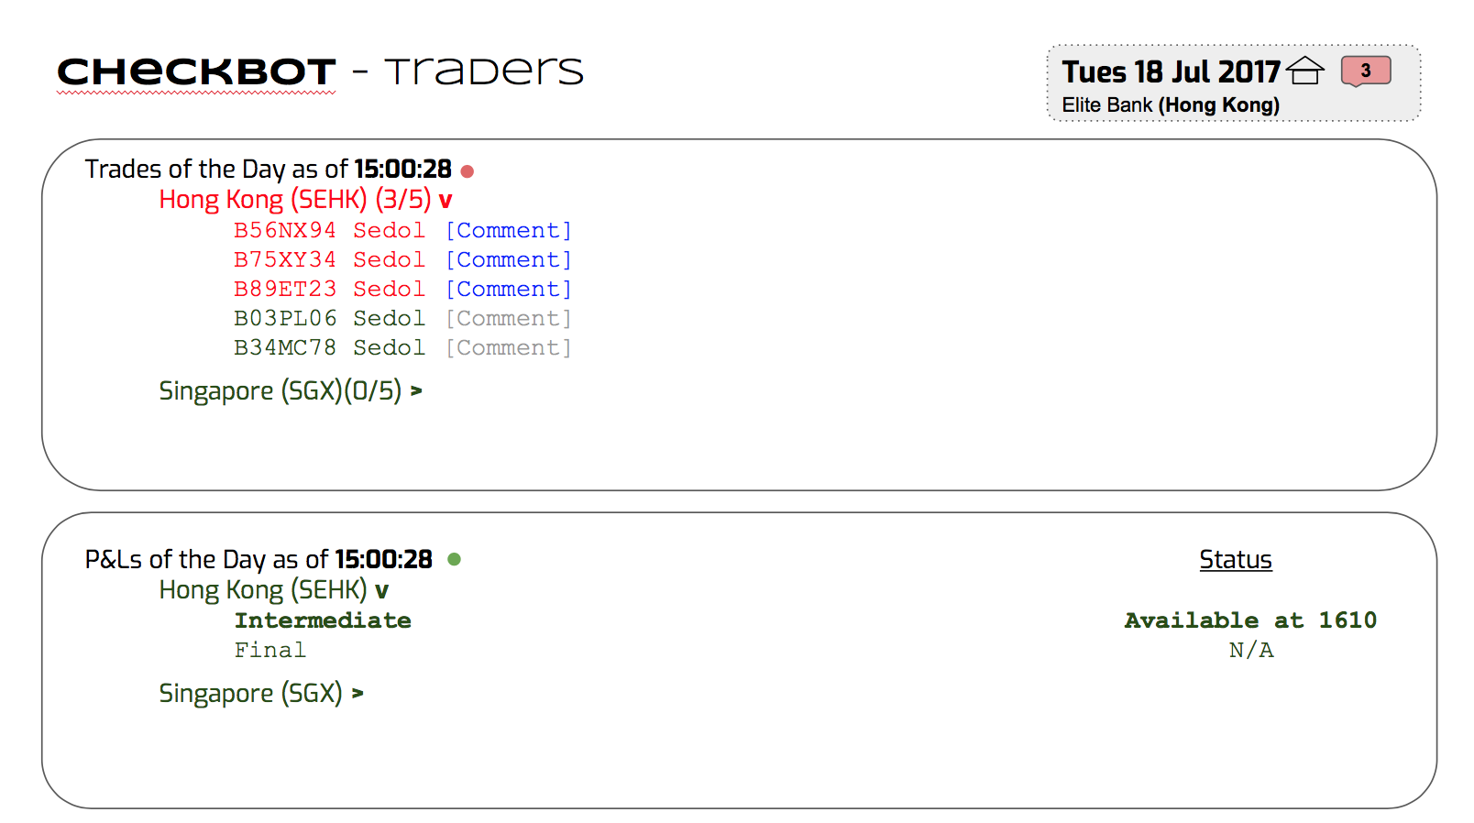
Demo:
Real-time data management (Trader)

Slide 38
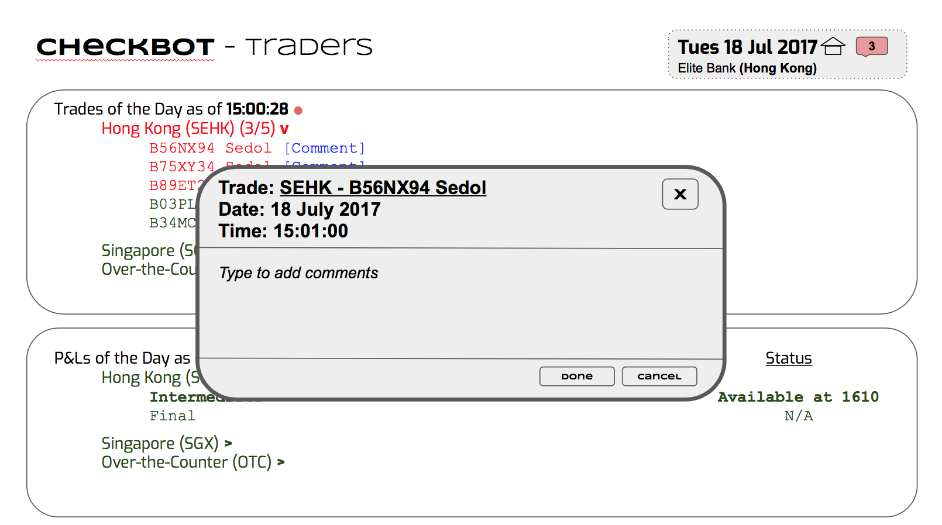
Demo:
Real-time data management (Trader)

Slide 39
Demo:
Real-time data management (Data Integrity Team)
CheckBot Alert (D.I Team)
Trade:SEHK - B56NX94 Sedol
Date: 18 July 2017
Time: 15:09:00
Issue Description: ...
X
Enter
Ignore

Slide 40
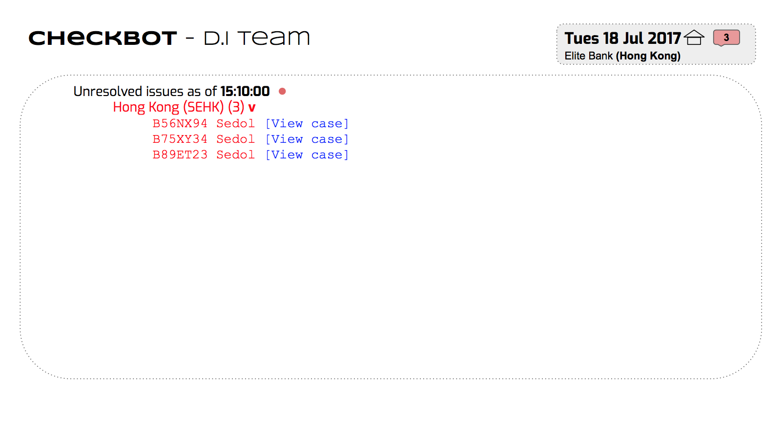
Demo:
Real-time data management (Data Integrity Team)

Slide 41
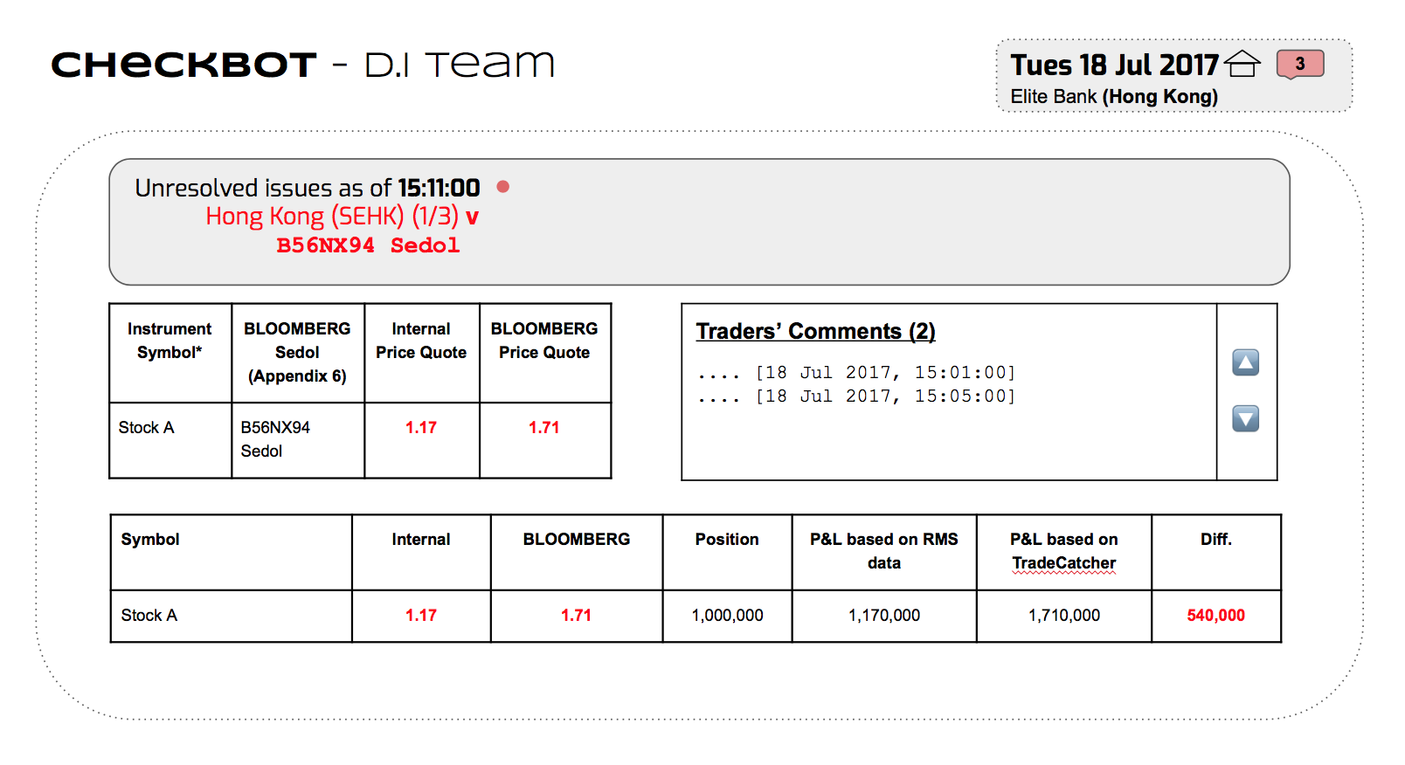
Demo:
Real-time data management (Data Integrity Team)

Slide 42
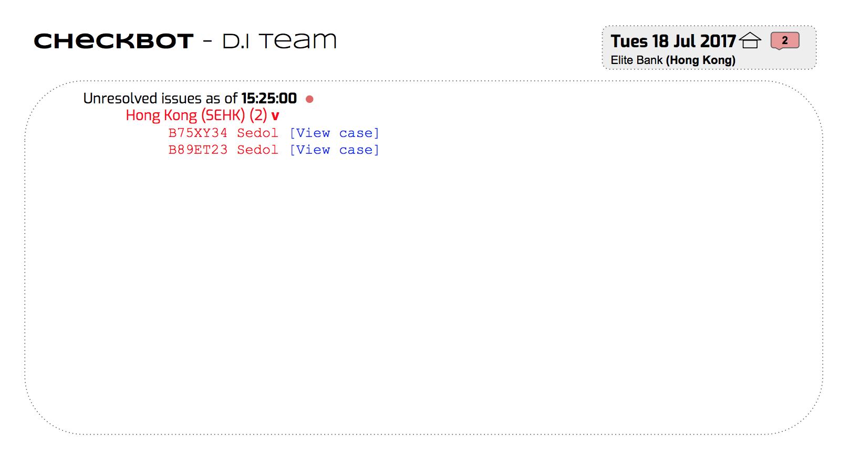
Demo:
Real-time data management (Data Integrity Team)

Slide 43
P&L Monitoring and Clearance

Slide 44

Demo:
P&L Monitoring and Clearance (P&L Team)
CheckBot

Slide 45
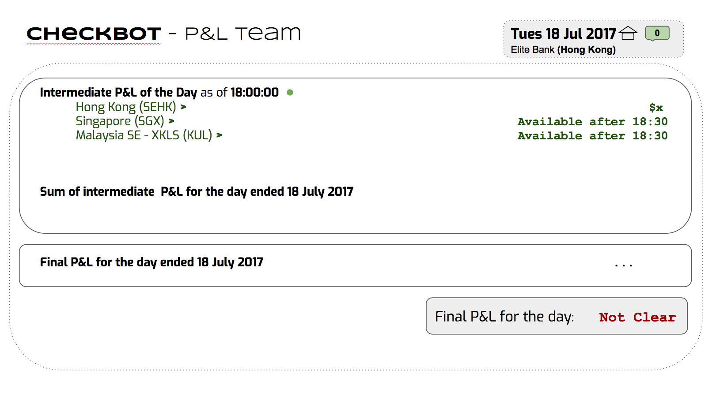
Demo:
P&L Monitoring and Clearance (P&L Team)

Slide 46
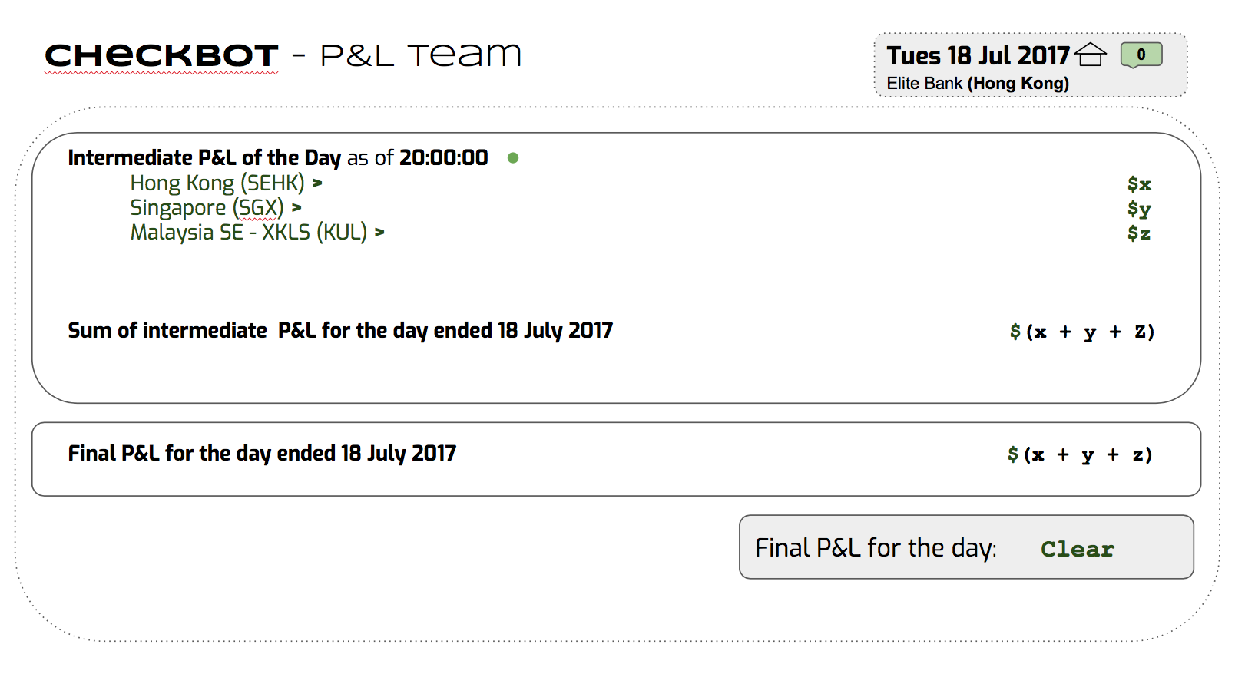
Demo:
P&L Monitoring and Clearance (P&L Team)

Slide 47
Process of resolving discrepancies

Slide 48
Demo:
Process of resolving discrepancies (Core Team of Analyst)
CheckBot Alert (C.A Team)
Error: Intermediate P&Ls mismatch!
Date: 18 July 2017
Time: 17:00:00
Issue Description: ...
X
Enter
Ignore

Slide 49
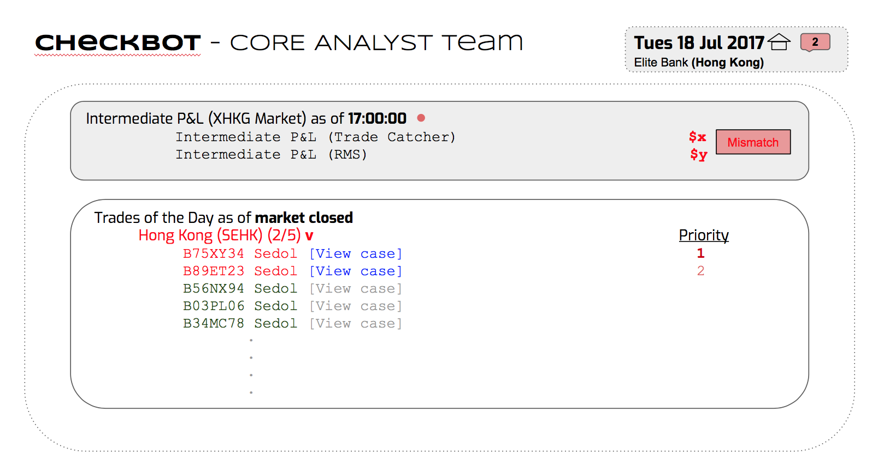
Demo:
Process of resolving discrepancies (Core Team of Analyst)

Slide 50
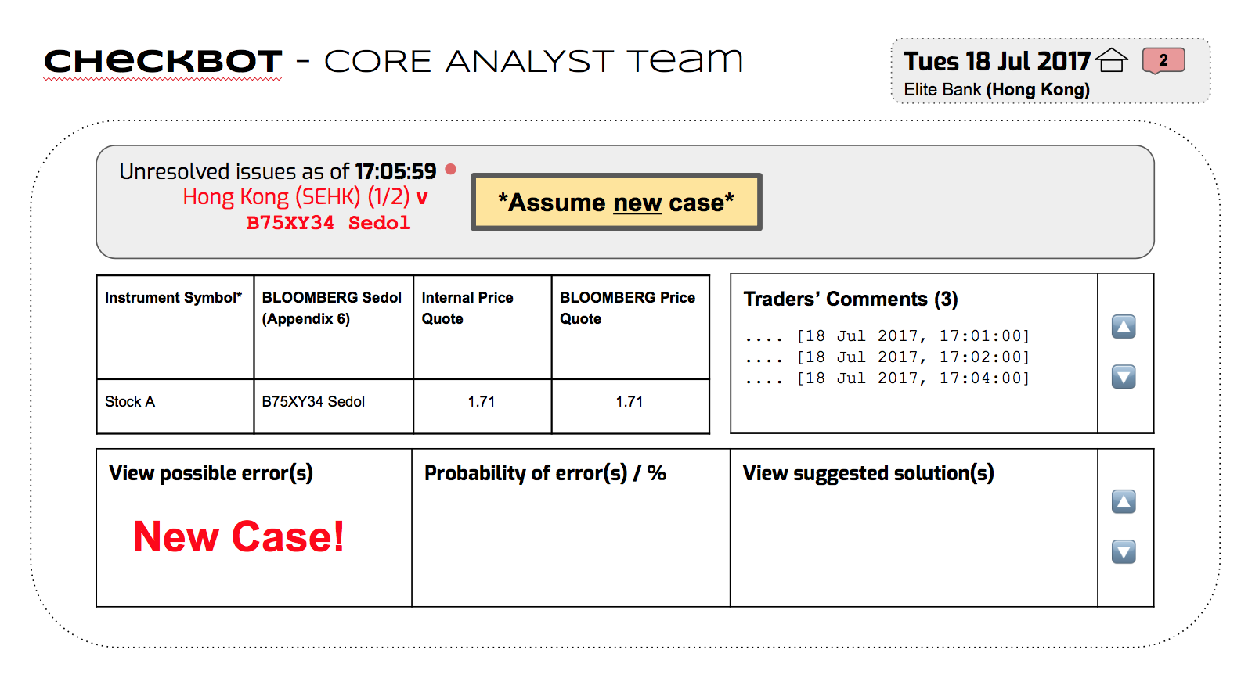
Demo:
Process of resolving discrepancies (Core Team of Analyst)

Slide 51
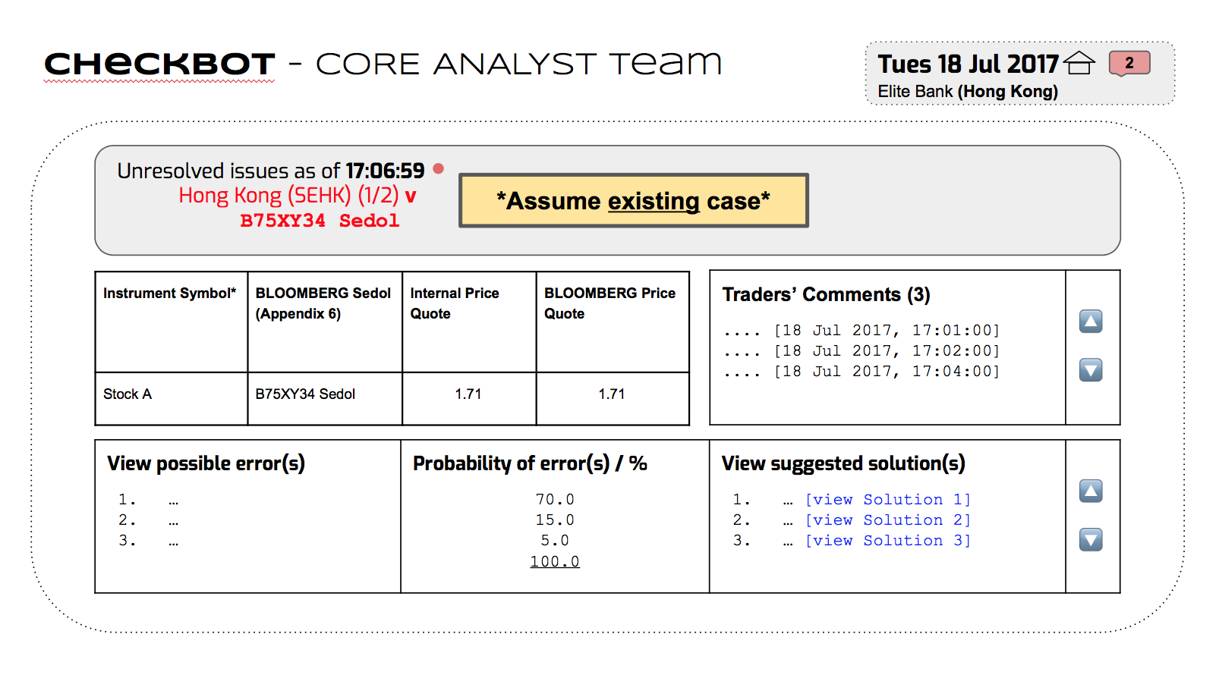
Demo:
Process of resolving discrepancies (Core Team of Analyst)

Slide 52
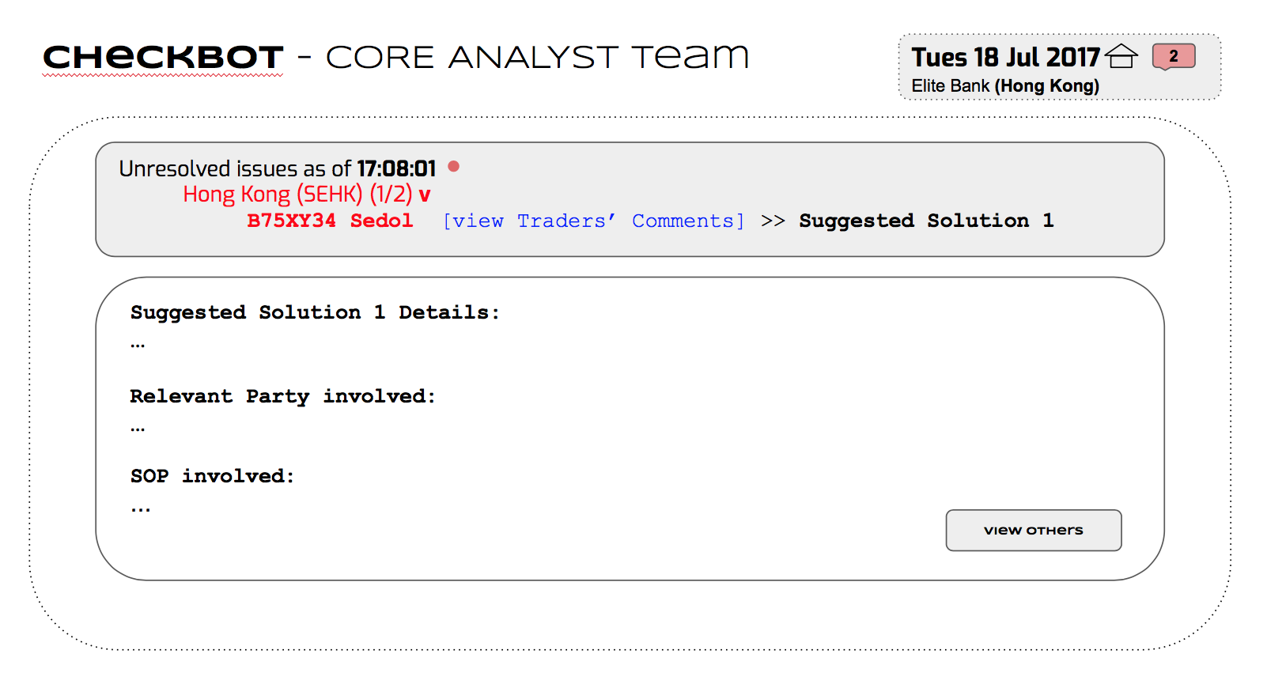
Demo:
Process of resolving discrepancies (Core Team of Analyst)

Slide 53
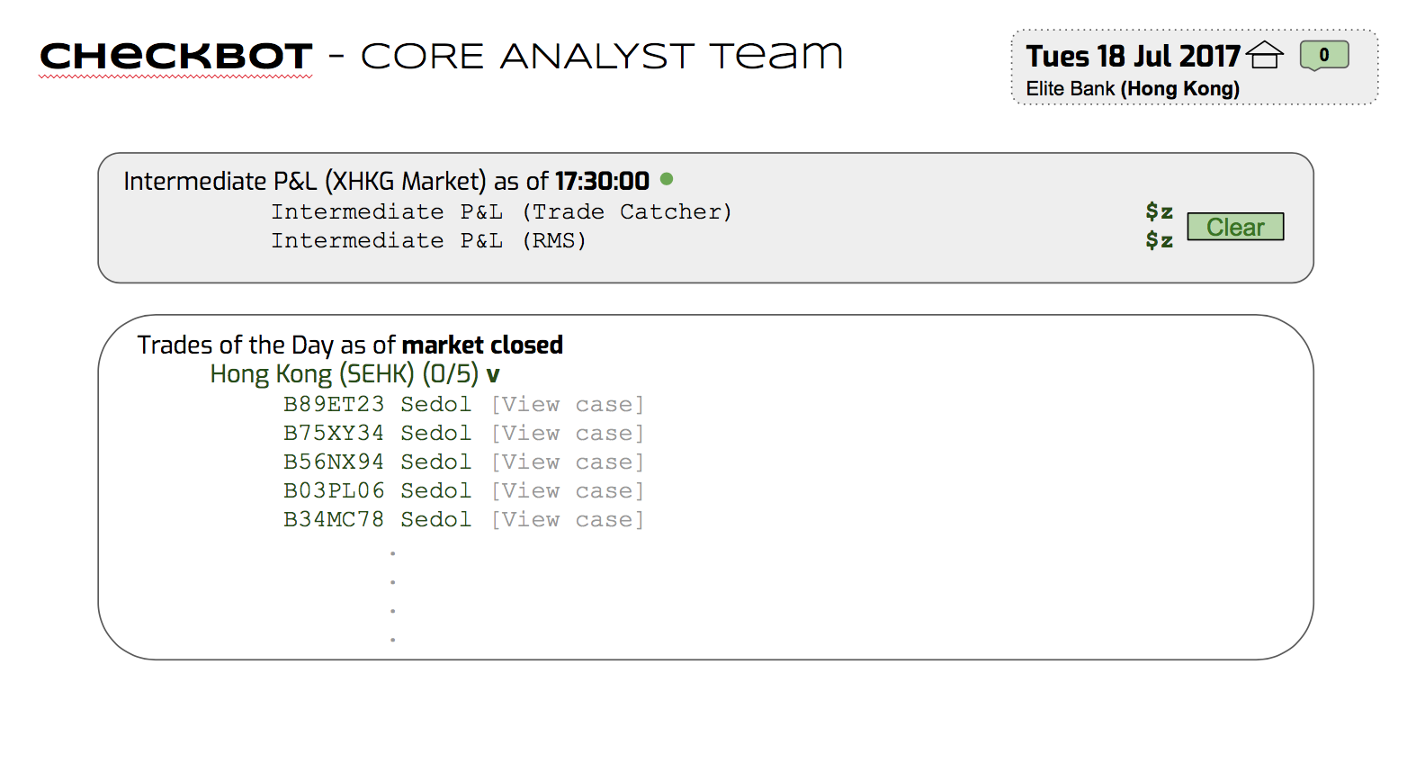
Demo:
Process of resolving discrepancies (Core Team of Analyst)

Slide 54
The Journey
Solution
Cost vs Benefits
Conclusion
Problem
Demo
Limitation

Slide 55
Cost of Implementation

Slide 56
Cost
Implementation of technology
Training cost
Integration cost
Risk of failed investment

Slide 57
Hard Benefits

Slide 58
Hard Benefits
Address Problems identified
Soft
Benefits
Hard
Monetary savings: Man-hours saved
Monetary savings: Less fines and compensation

Slide 59
Hard Benefits:
Addressing problems identified
Focus on corrective measures instead of preventive actions
Designing out root causes
Inefficient problem identification and solving process
Lack of real-time checking and management system
Outsourcing of skilled expertise & Machine Learning
First Line of Defence

Slide 60
Hard Benefits:
Monetary saving → man-hours
Streamlining of problem identification & solving process
2. Reduced frequency and complexity of mistakes

Slide 61
Hard Benefits:
Monetary saving → man-hours
Category | Original Required Capacity | Improved Required Capacity (Estimated) | Justification
P&L reporting | 75 | 32 | Auto-generation of P&L Reports Investigation of discrepancies are outsourced to Core Team of Analyst Expected to have reduced P&L suspension
Ledger control | 65 | 55 | P&L Team is still expected to close the ledger CheckBot system unable to adjust quickly to various financial regulations
Market data integrity | 15 | 5 | Data input are verified by Enhanced Market Box at early stage
Others | 30 | 25 | Significant man-hour is still necessary to ensure the stability and robustness of CheckBot

Slide 62
Estimated potential reduction in headcount and manpower cost: P&L Reporting Team = 4 Market DI Team = 1
Hard Benefits:
Monetary saving → man-hours
Estimated improve in efficiency = 68/185 = 0.368 = 37%
The total saving on manpower cost per year = 5 x $58,500*
= $292,500
*Salary of UBS SG Operations Analyst Salary per year as quoted from Glassdoor Website.

Slide 63
Hard Benefits:
Monetary saving → Less fine & Compensation
Number of P&L Discrepancies fall
Decrease in compensation due to manual mistakes
Less fines & Compensation

Slide 64
Soft Benefits

Slide 65
Soft Benefits
Better work-life balance
Hard
Benefits
Soft
Reputation enhancement

Slide 66
Soft Benefits:
Better work-life balance for employees
More than 120 % or at least full capacity
Eased workload promotes work-life balance

Slide 67
Soft Benefits:
Reputation enhancement
Support for an organization during times of crisis of controversy
Yields benefit from good reputation
Essential for the company’s survival
Consumers’ Preferences
Gain trust and confidence
Future value for the company in financial market
Word of mouth

Slide 68
The Journey
Solution
Cost vs Benefits
Conclusion
Problem
Demo
Limitation

Slide 69
Limitations
Engaging Core Team of Analyst in problem solving process
Possible cases of inaccurate identification of problems
#2
#1
#3
Collection of large amount of data and cases
Implications of new complicated financial products
Takes time to reach optimal efficiency
Potential fail-soft measure to put in place
Feeding of hypothetical cases in preliminary stage of new financial products

Slide 70
The Journey
Solution
Cost vs Benefits
Conclusion
Problem
Demo
Limitation

Slide 71
Projection into the future

Slide 72
Conclusion:
Projection into the future
Integration with more operating systems
Self-automation

Slide 73
Summary

Slide 74
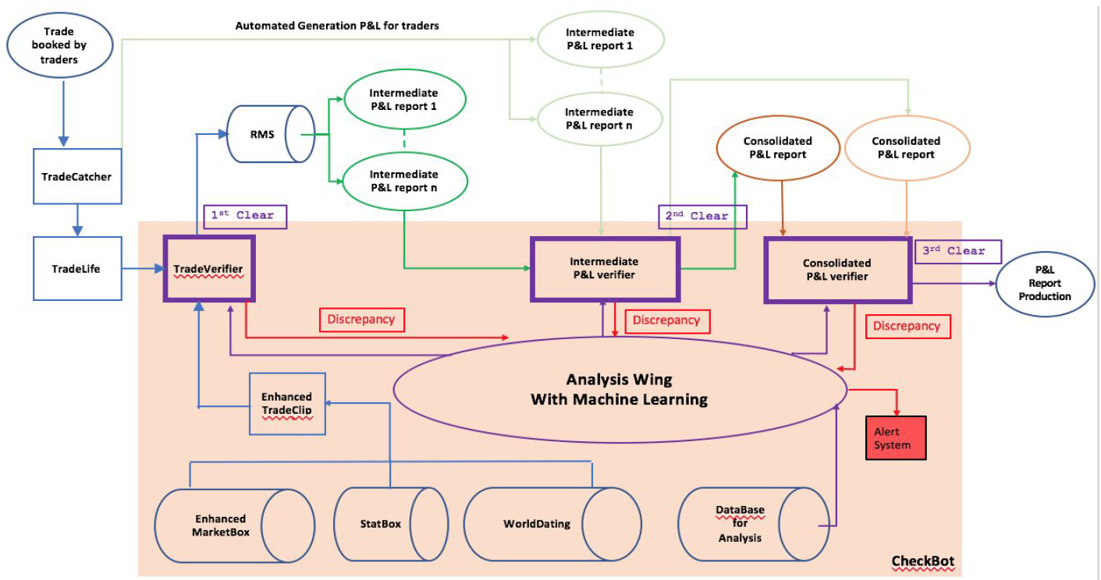

Conclusion:
Summary
Good Operational Flow
Good Flow of Cheques
CheckBot

Slide 75
Conclusion:
Summary
Thank you

